Slide 1
Amity University – Communication skills for Entrepreneurs
Pankaj Sharma

Slide 2
Entrepreneurship is leadership

Slide 3
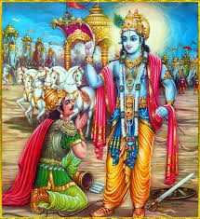
Communication

Slide 4
Challenges
Thoughts and emotions feed each other
New information
Not letting go
Auditory versus visual
KISS versus Storytelling

Slide 5
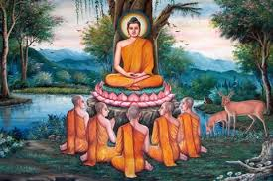
Communication

Slide 6
Communication
Equanimity
Exuberance
Empathy

Slide 7
Stake holders
Whom they communicate with
Investors
Customers
Employees
Partners

Slide 8
Types Of Communication
Sell
Persuade
Negotiate
Conflict resolution

Slide 9
Good Communication
Asking
Research
Observation
Validation
Objectivity
Precise
Presentation Skills
Body language

Slide 10
Abilities/Situations/choices

Slide 11
Thank You

